Slide 1
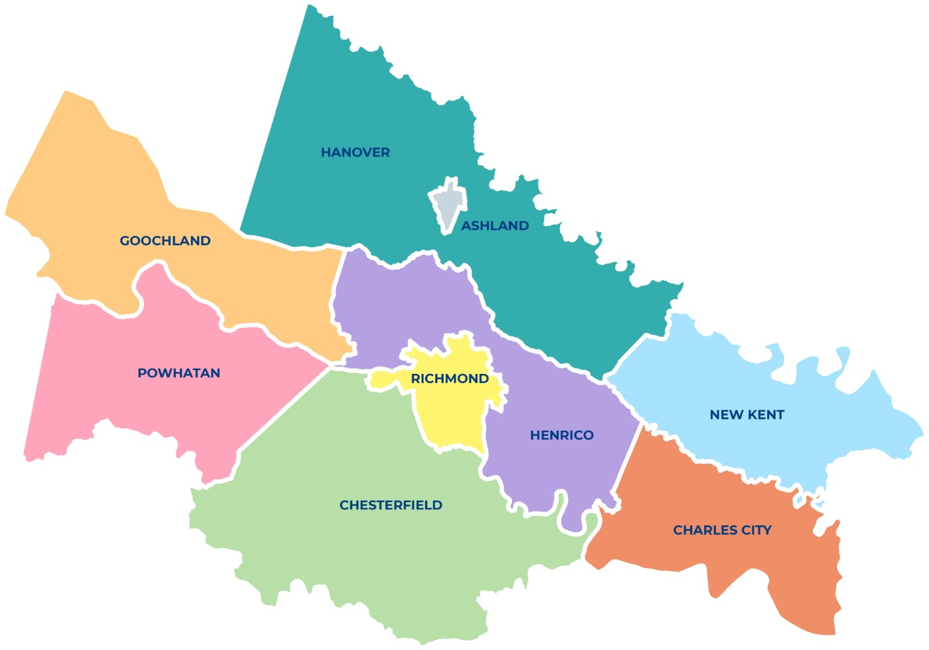



Dynamic Traffic Assignment (DTA) Models Using Streetlight OD Data
Application of Big Data – Richmond, VA
17th TRB Transportation Planning Applications Conference
Sulabh Aryal- PlanRVA(RRTPO)
Srin Varanasi- Corradino
Aditya Katragadda- Corradino
Ken Kaltenbach- Corradino
June 2-5, 2019

Slide 2
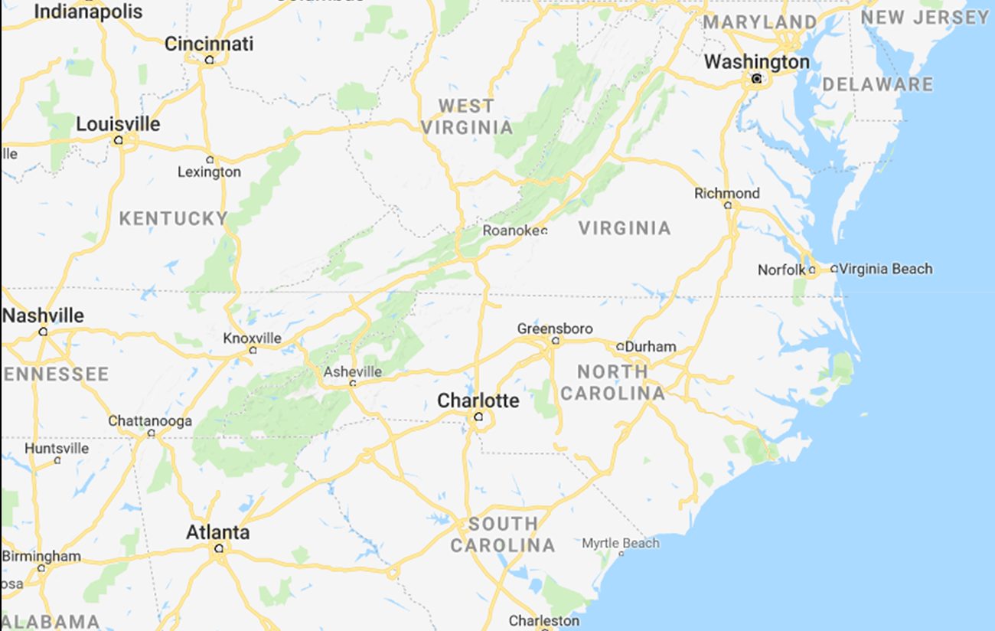
Location of the Study Area

Slide 3
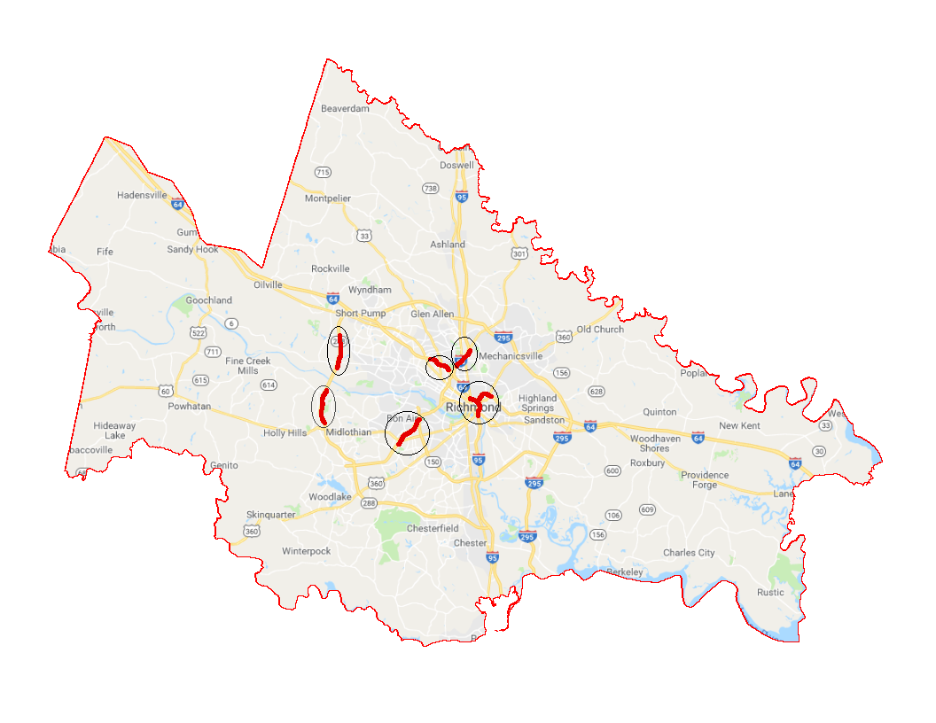
Major Chokepoints in the Richmond Region
VA-288 South
Tuckahoe Creek Pkwy to VA-6
I-95 South
US 1 to VA-161
I-64 East
US-250 to US-33
I-64/I-95/I-195
VA-288 North
US-60 to VA-711
VA-76 N
US-60 to VA-150

Slide 4
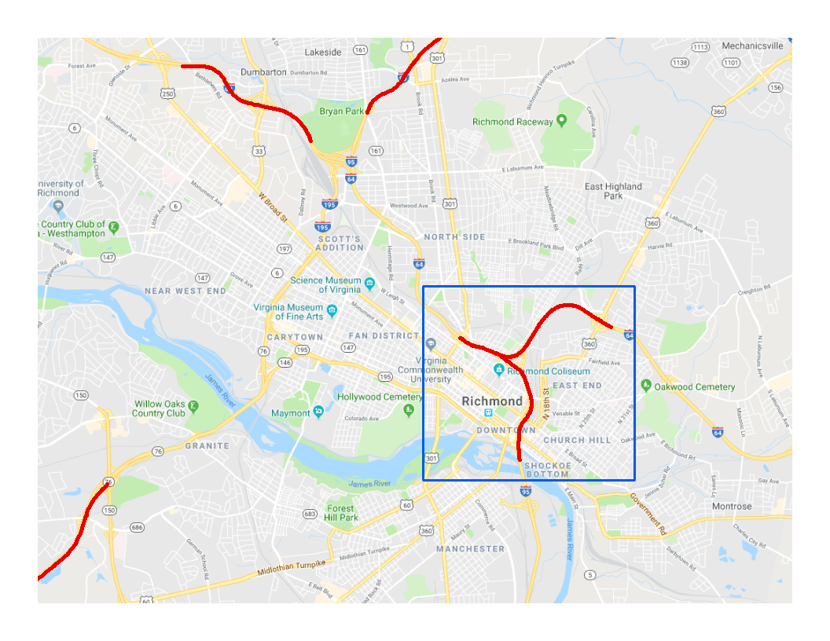
Objectives of the Study
Richmond, VA- DTA Study Area
  To have a deeper look of one of the major chokepoints in the region
  To develop a mesoscopic DTA application for scenario testing
  Explore the use of Big Data like Streetlight OD data in the corridor model development
  Test applications such as freeway bottleneck analysis

Slide 5
Tools Selection and Development
  Streetlight OD data and Expansion
    LBS and GPS Navigation OD data within the subarea
    Provides traffic flows (corridor subarea OD) using “Pass-through” zones
    Expand using ODME process, with a feedback loop with highway assignment
  Develop DTA Subarea Application
    Peak period specific routine
    AM ( 7 AM – 9 AM)
    PM (5 PM – 7 PM)
    Time slice OD expanded data to 15 minute interval
    Validated model using counts and observed speed at 15 minute interval

Slide 6
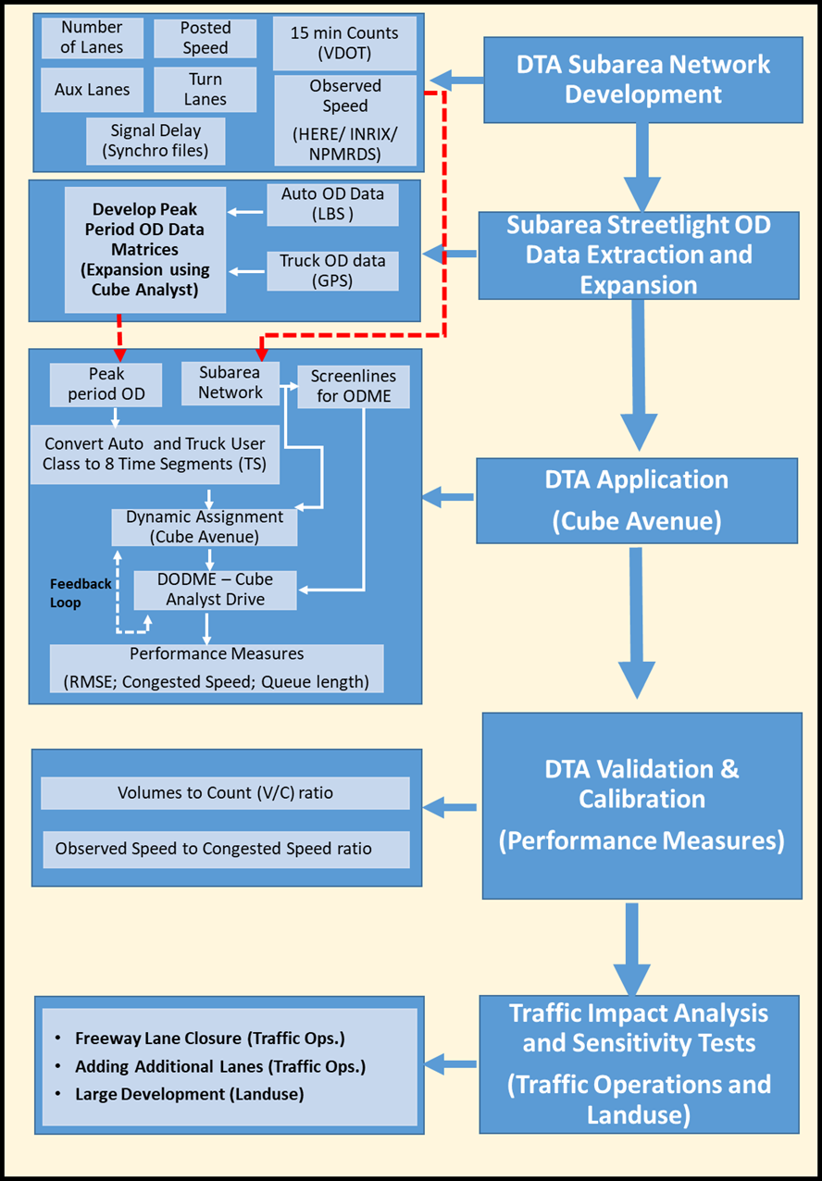
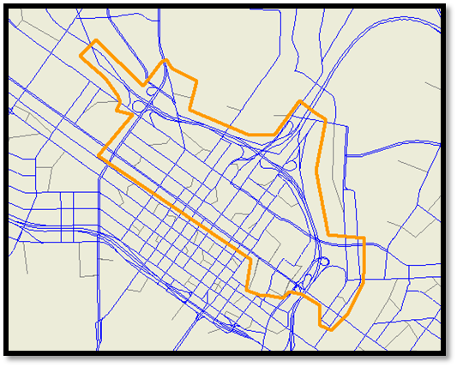


Overall Subarea Modeling Process

Slide 7
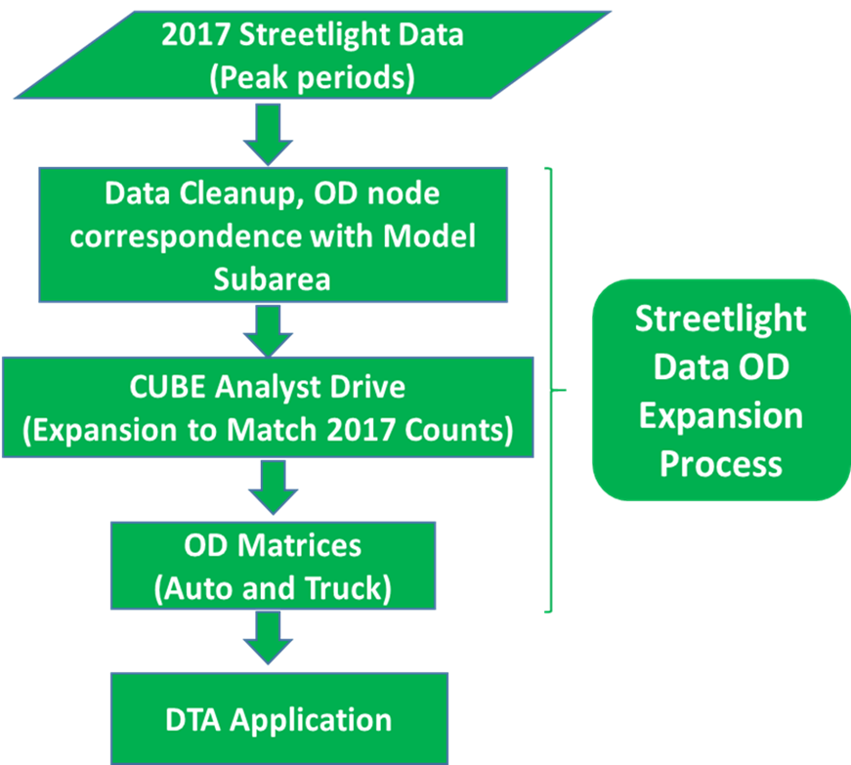
Streetlight Data OD Expansion Process

Slide 8

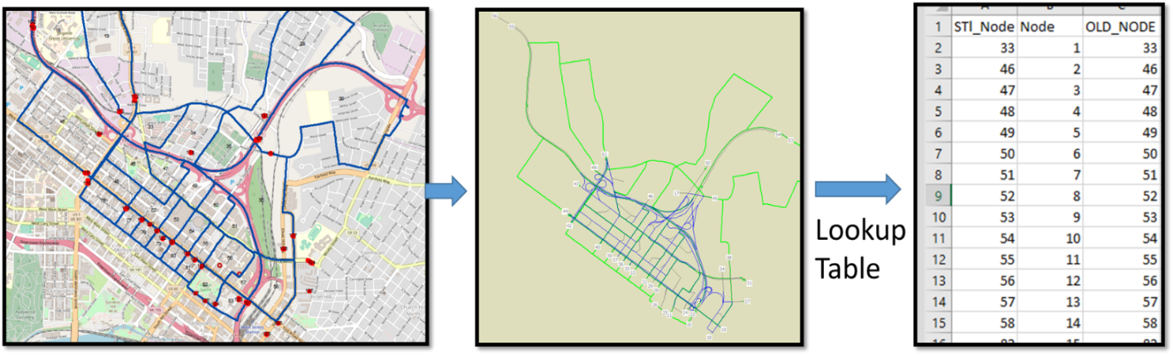
Streetlight Data Processing
Create Pass-through Zones that Match Subarea External Zones
  Create Subarea Boundary & Extract Subarea Network
  Create pass through polygons perpendicular to the network link
  All polygons correspond to “directional” links
  The zone names are automatically assigned by streetlight
  Correspond these to the model external nodes using a lookup table (GIS/manual process)

Slide 9
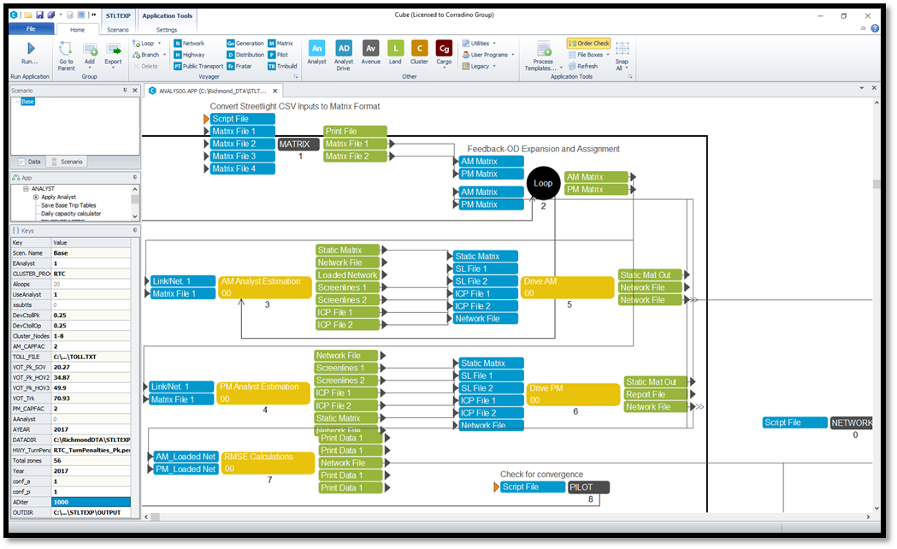
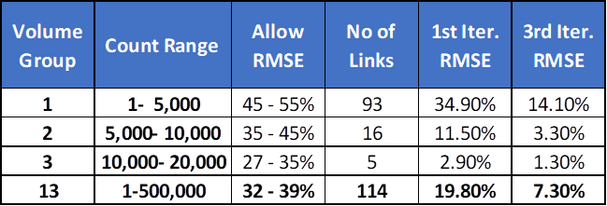
2017 Streetlight OD Data Expansion Routine and Results
Feedback Loop Between Cube Analyst ODME and Highway Assignment
  2-hours AM, PM Peak Period Streetlight OD Data Inputs
  Auto and Truck
  AM, PM Period Traffic Count Targets
  Expanded AM, PM Period OD Matrices Outputs

Slide 10
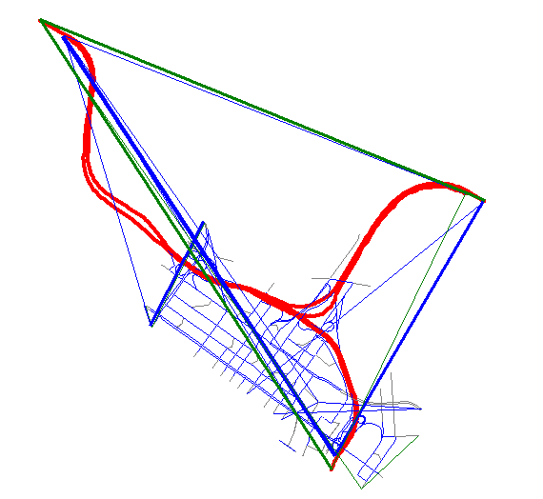
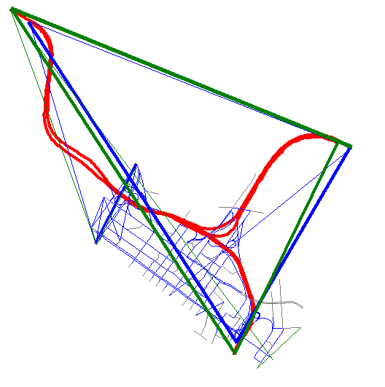


Results Discussion- 2017 OD Travel Patterns Comparison
2017 Streetlight-Raw Calibrated Project Index- AM Peak Period
2017 Streetlight-Expanded Calibrated OD Trips - AM Peak Period

Slide 11
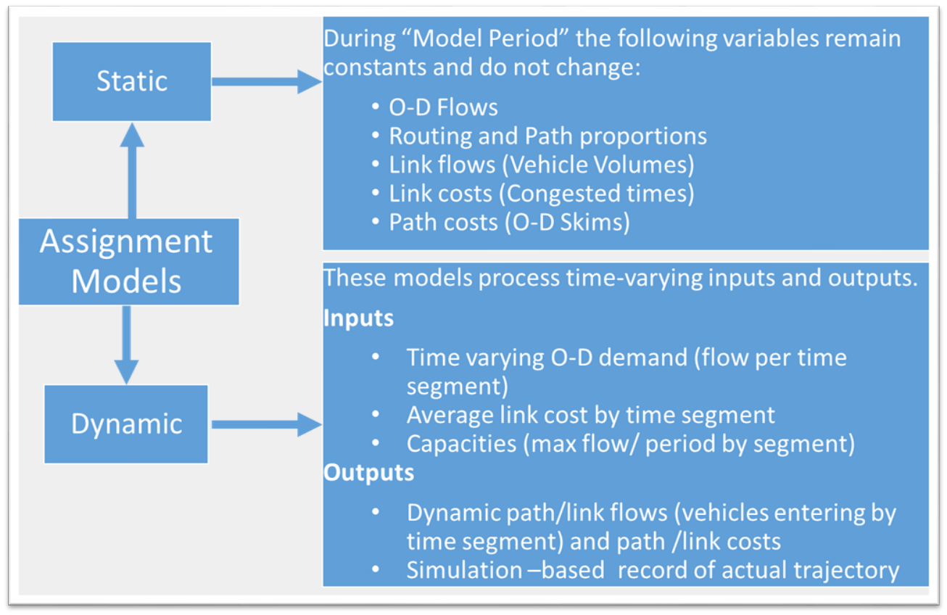
Dynamic Traffic Assignment (DTA) Principles
  Method of system-level assignment analysis which seeks to track the progress of a trip through the network over time
  Accounts for formation and propagation of queues due to congestion
  A bridge between traditional region-level static assignment and corridor-level (micro-simulation)

Slide 12
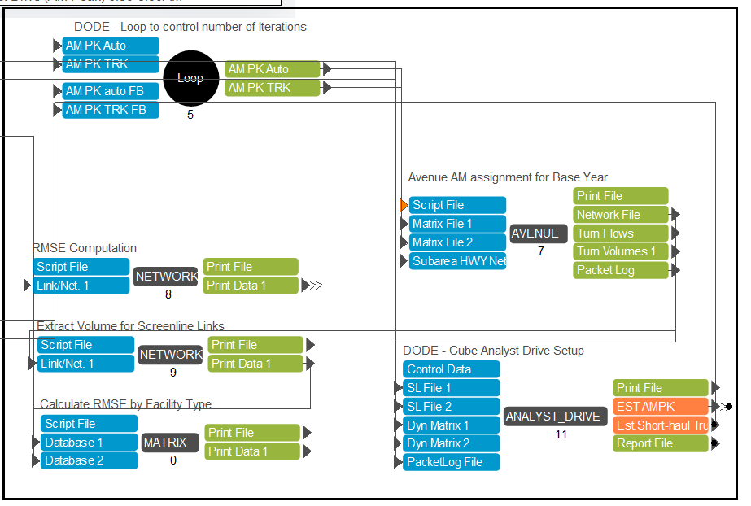
2017 Peak Period DTA Application- AM Peak Multi Class DTA

Slide 13
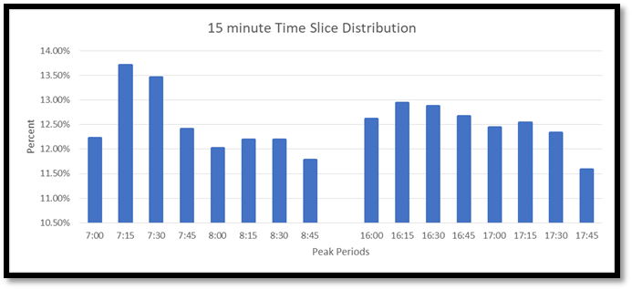
CUBE Avenue-based DTA Process
  Fine-grained subarea network development- Key Inputs
    True Shape with Distances
    Link Capacities (Vehicles per hour per lane)
    Link Storage (Vehicles per Mile Per Lane)
  Time-slicing the OD matrices – (15-minute increments), and 15-minute warm-up
  DTA distributes the 15-minutes segment-specific demand into “packets”
  Link costs are updated for every 15 minutes, based on volume-delay functions
  DTA internally estimates queues at link nodes depending on Link Capacity and storage.
  Packets depart randomly using uniform distribution within each time segment

Slide 14
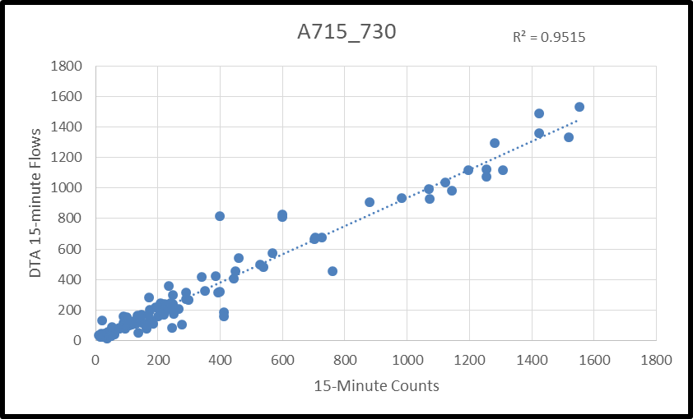
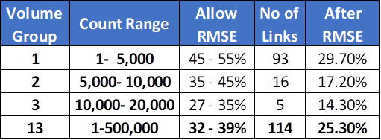
DTA Calibration Results (AM Peak)
  Congested Speed Calibration
  Vehicle flows Vs Counts
  Visual checks, Animation, Queues

Slide 15
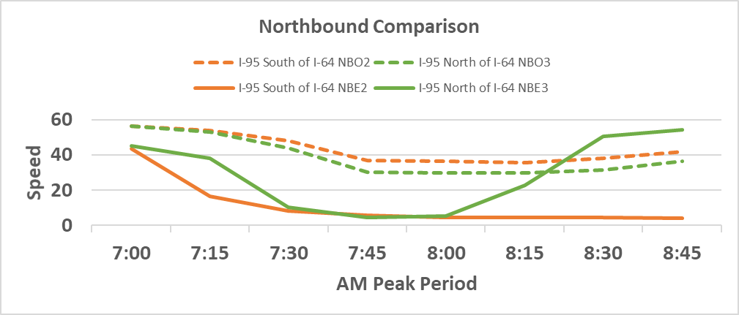
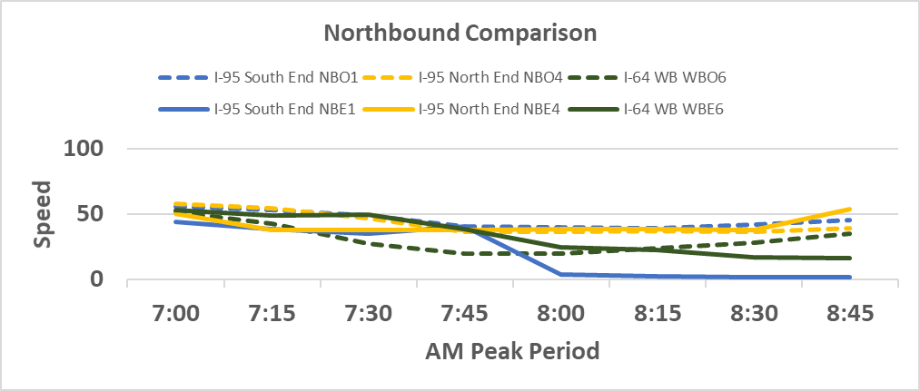
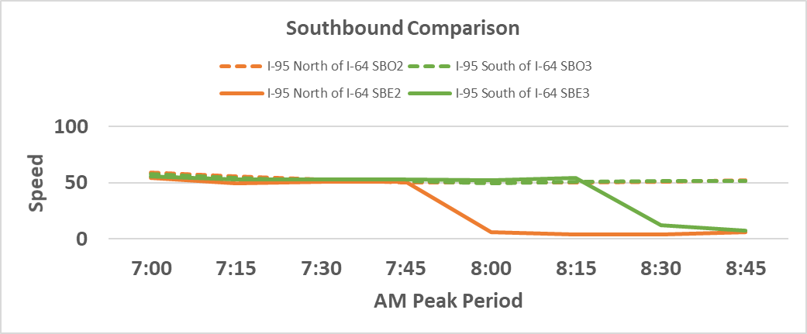
DTA Calibration Results (AM Peak)
I-95 NB Observed VS Estimated Calibration Set 1
I-95 NB Observed VS Estimated Calibration Set 2
I-95 SB Observed VS Estimated Speed Calibration Set 1
I-95 SB Observed VS Estimated Speed Calibration Set 2

Slide 16
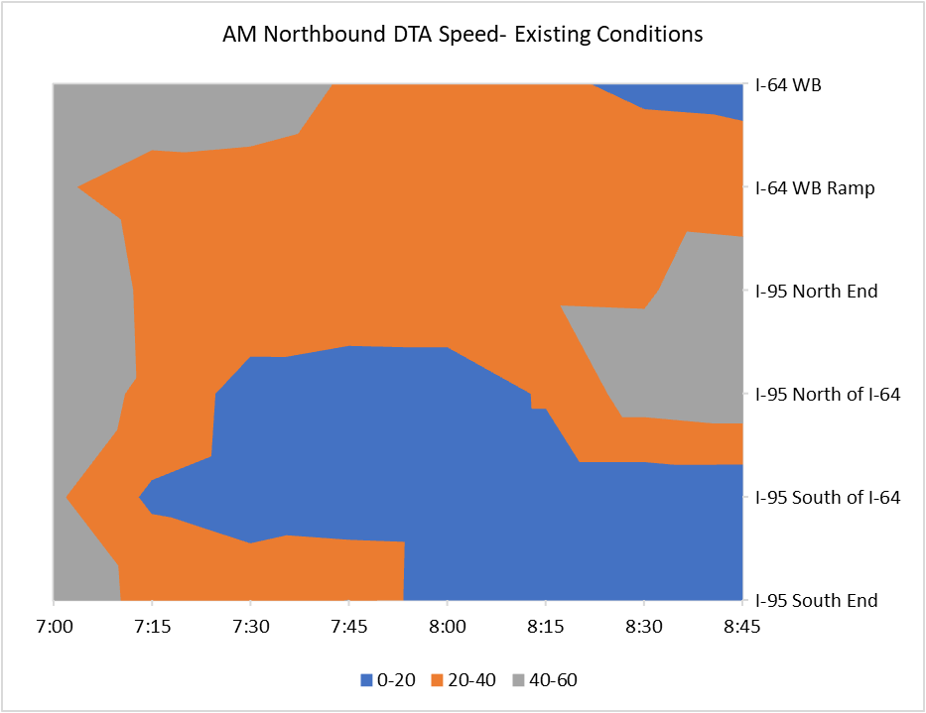
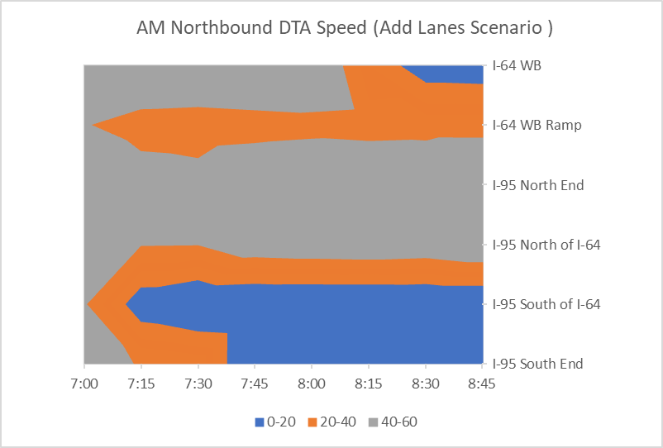
DTA Application- Scenario1 (1 Additional Lane on I-95)

Slide 17

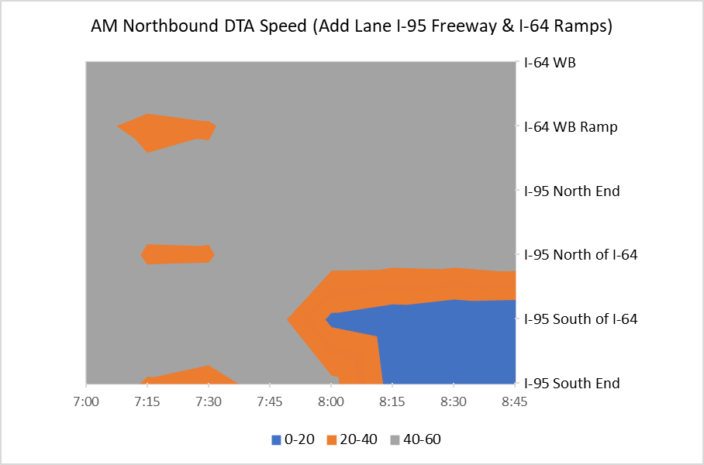
DTA Application- Scenario 2
(1 Additional Lane on I-95 & 1 Additional Lane on I-64 Ramps)

Slide 18
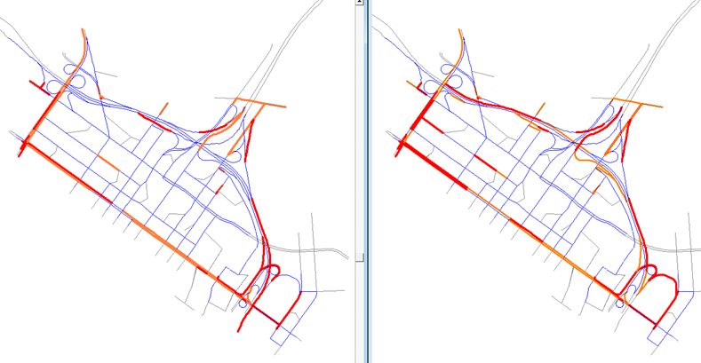
DTA Application- Scenario1 (1 Additional Lane on I-95)
AM Period Subarea System Impacts
8L Scenario
Existing Conditions
    > 20 mph
10-20 mph
<10 mph

Slide 19
Conclusions & Lessons Learned
  Streetlight data was effectively used in developing the subarea demand, with careful OD expansion methods.
  DTA calibration replicates the bottleneck conditions at the I-95/I-64 interchange
    Merges of major roadways and movements
    Short ramp segments
    Heavy AM/PM loads
  The DTA Model provides the TPO with capabilities to analyze bottlenecks and recommend mitigation measures
  This approach minimized the needs for expensive data collection
    Use of already available traffic count data, OD and speed data from Big data sources- Streetlight/HERE
  Mesoscopic DTA model requires extensive calibration and sensitivity analysis
    Delicate compromise between volume/count and congested speed calibration
    Observed data should be carefully chosen for the calibration

Slide 20

Thank You!
Sulabh Aryal, AICP
Transportation Planning Manager,
PlanRVA (Richmond Regional TPO)
saryal@planrva.org
www.planrva.org
Srin Varanasi
Vice President, Transportation Systems Planning
The Corradino Group
svaranasi@corradino.com
www.corradino.com

